Slide 1
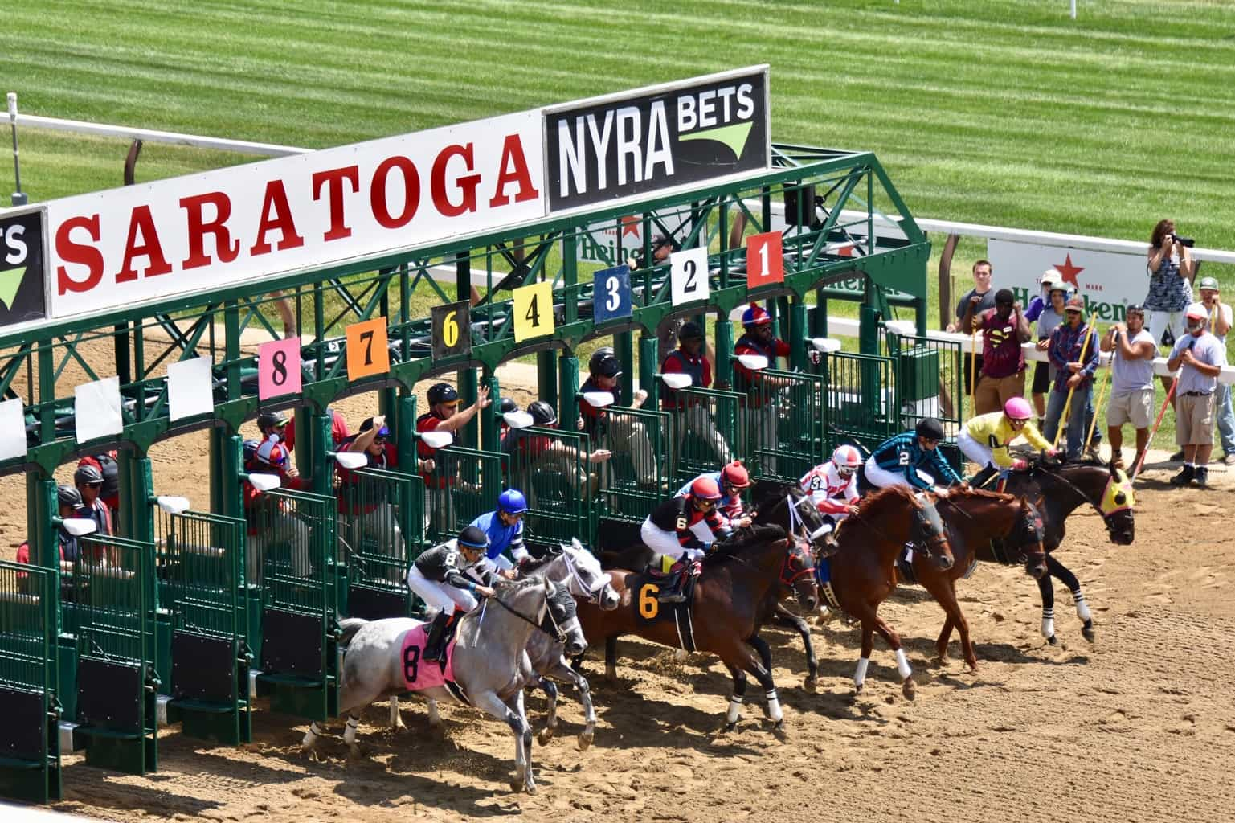
Horse Racing Data Analysis
Data Analytics Project
10.11.2022
Team Leo!
Ishita PES1UG20CS648, Hita PES1UG20CS645

Slide 2
Line Up
An Introduction
EDA
Clustering
Preprocessing
MLR, DL Neural Net, Inference

Slide 3
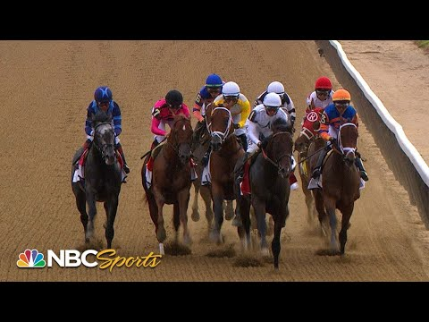
Ever seen a horse race?
Have a look now ⬅️
http://www.youtube.com/watch?v=89N4rRBxa88

Slide 4
Introduction
America’s most prestigious and oldest horse races are held annually at Aqueduct, Belmont, Saratoga.
Each horse is tracked every 0.25 seconds using trakus index (real-time tracking system that determines the exact geographical location of the horse.
Some nuggets 🍗
1. Purse
2. Drafting Strategy
3. Maiden Races
4. Stakes
5. Allowance Races
6. Claiming Races
7. Odds
8. Jockey
9. Race Course Types - Hurdle Surfaces, Turf and Dirt
10. Track Conditions - Muddy, Sloppy, Firm, Yielding

Slide 5
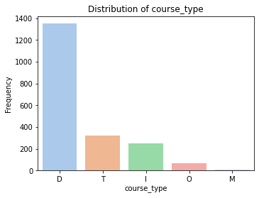
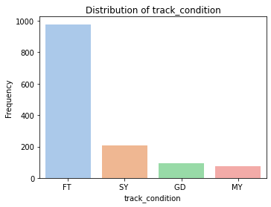
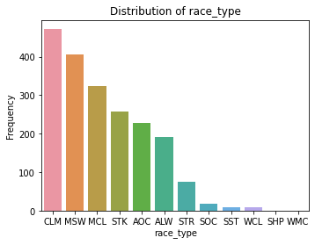
EDA
D - Dirt
T - Turf
I - Inner Turf
O - Outer Turf
FT - Fast Track
SY - Sloppy
M - Muddy
GD - Good
CLM - Claiming
MSW - Maiden Special Weight
STK - Stakes

Slide 6
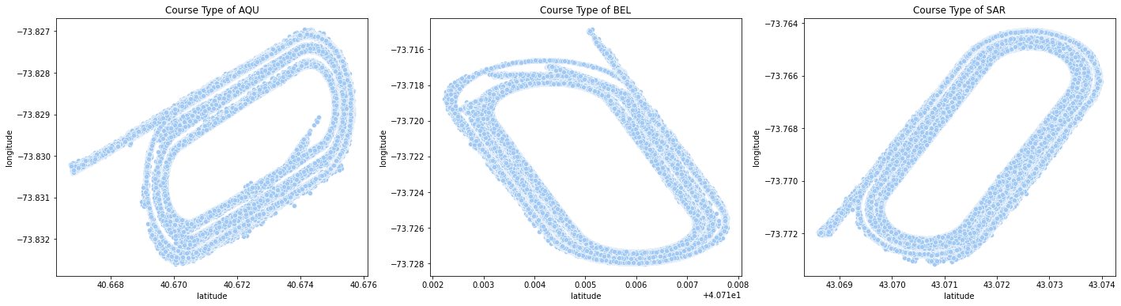
Scatterplots of the racing track at the 3 locations, Aqueduct(AQU), Belmont(BEL) and Saratoga(SAR)

Slide 7
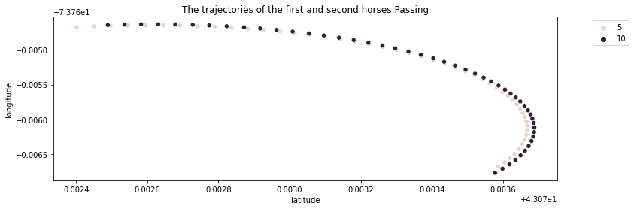
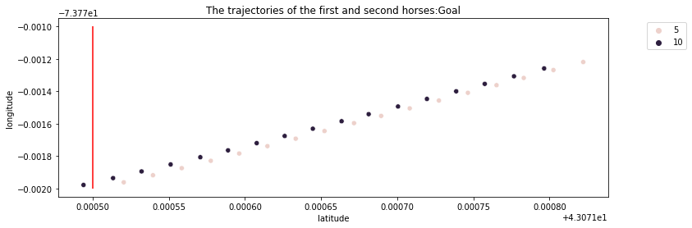
Scatterplot of the trajectory followed by the winner and runner-up horse at the finish line.
Close up of the first horse overtaking the second.

Slide 8
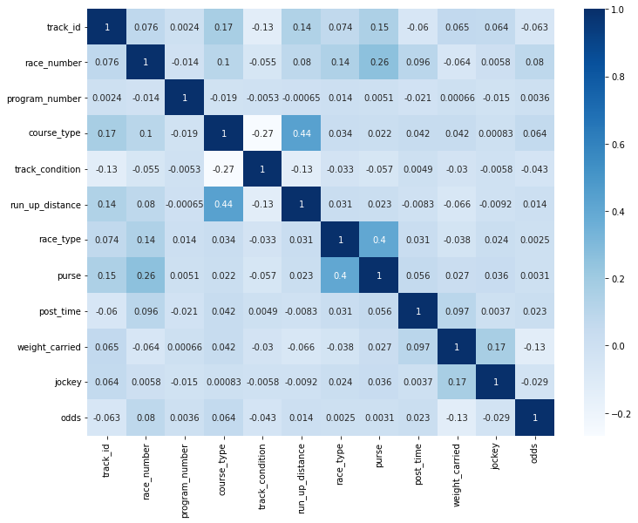
Correlation heat map of chosen relevant attributes.
Attributes that show high degree of correlation:
course_type and run_up_distance = 0.43
purse and race_type = 0.42

Slide 9
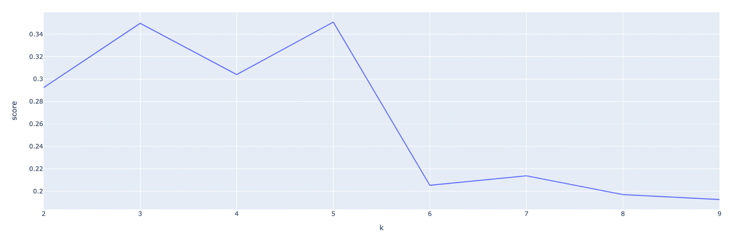
Unsupervised Learning - Clustering
The aim is to find any patterns/understand the racing data more.
K means clustering followed by agglomerative clustering(hierarchical clustering) is implemented.
Elbow plot for K means Clustering.
Optimum value, K=6
The graph is a oscillating a bit until 5 clusters.

Slide 10
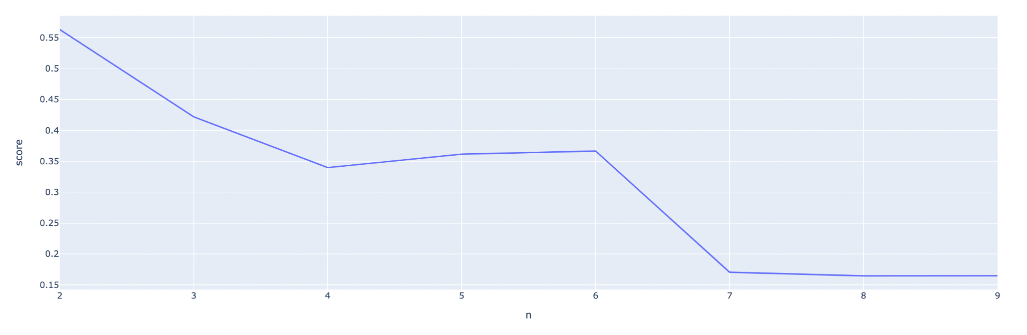
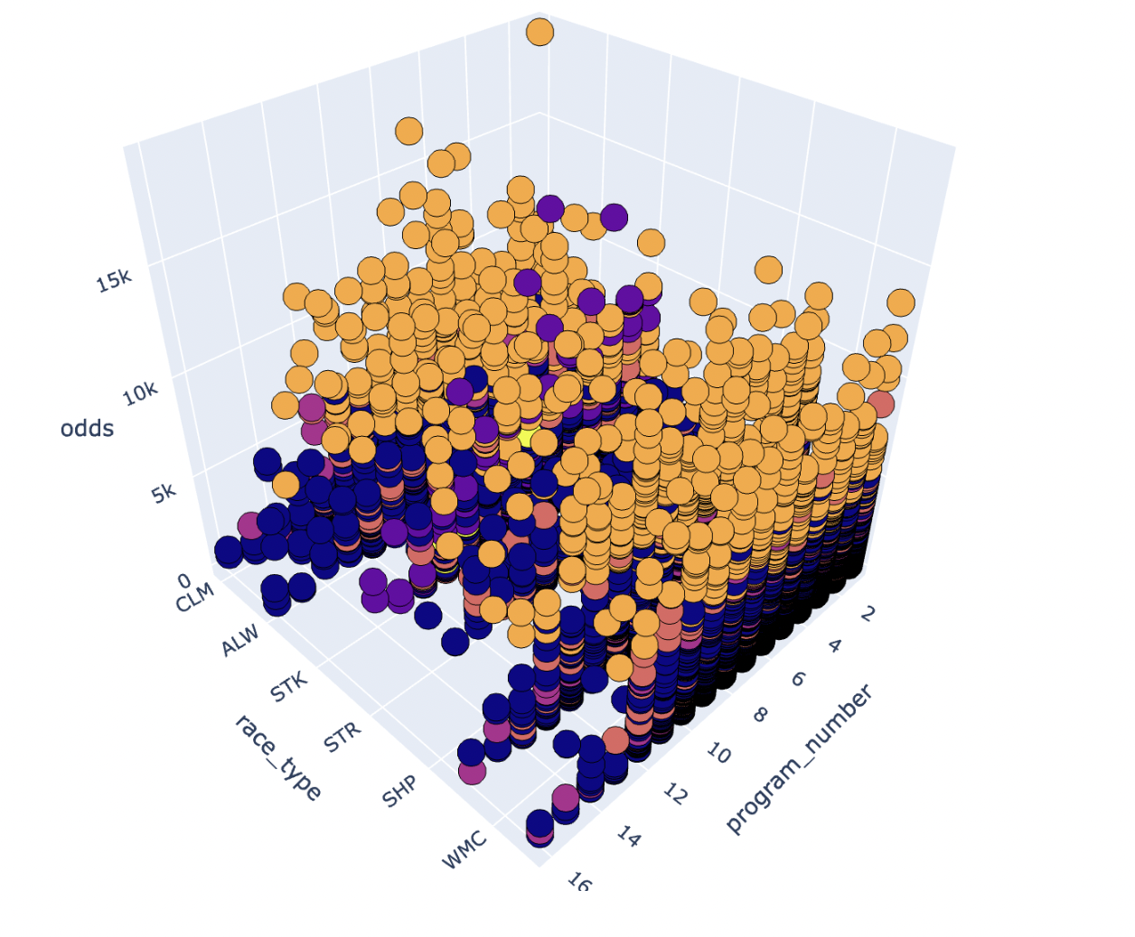
Elbow plot for Agglomerative Clustering.
Optimum value, K=6.
We proceed with this as it has an appropriate knee shape.
3D Overview of clusters formed of data points.
(with respect to race_type and program_number(unique identifier of a horse))

Slide 11
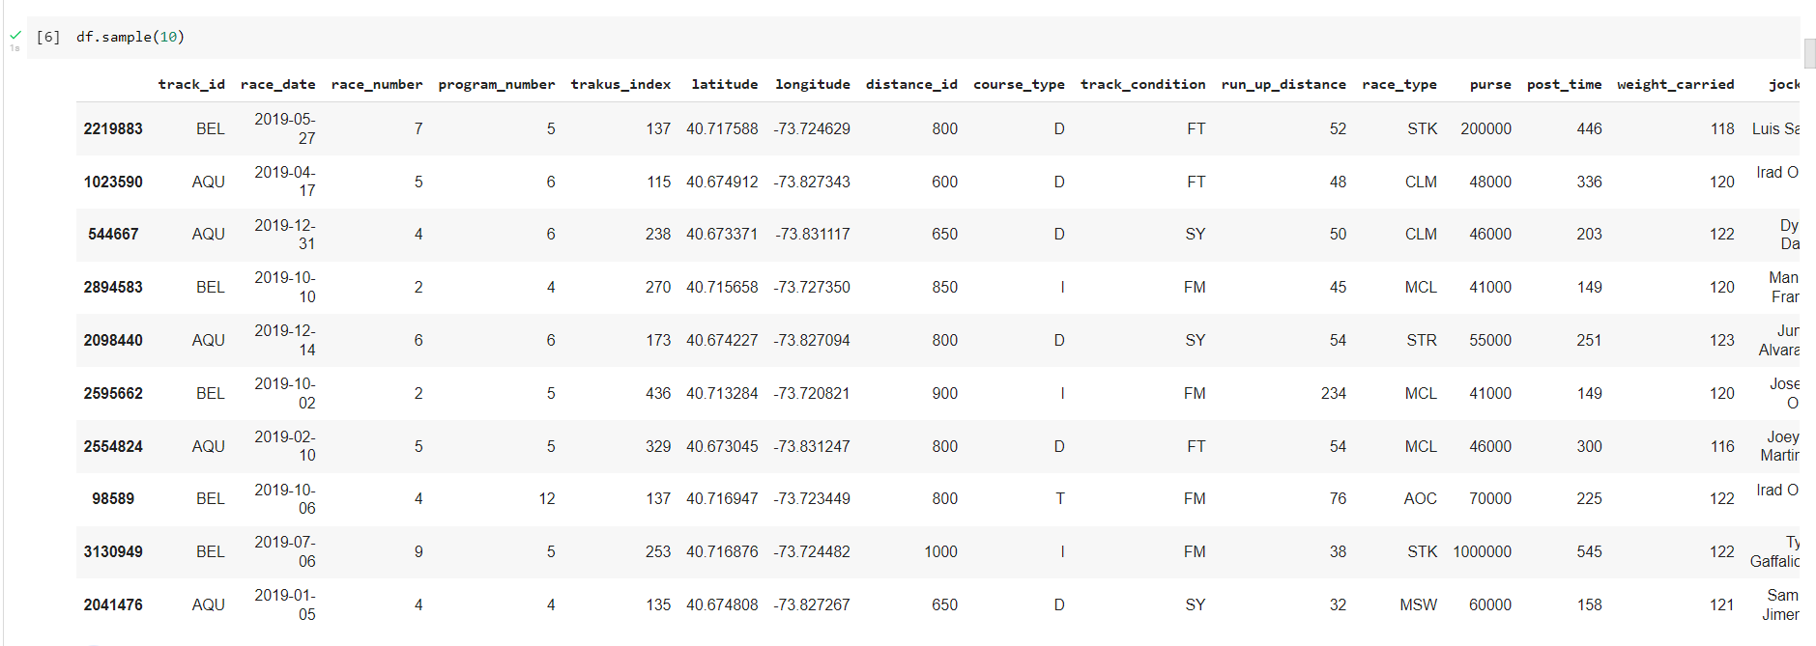
Preprocessing
Before Preprocessing

Slide 12
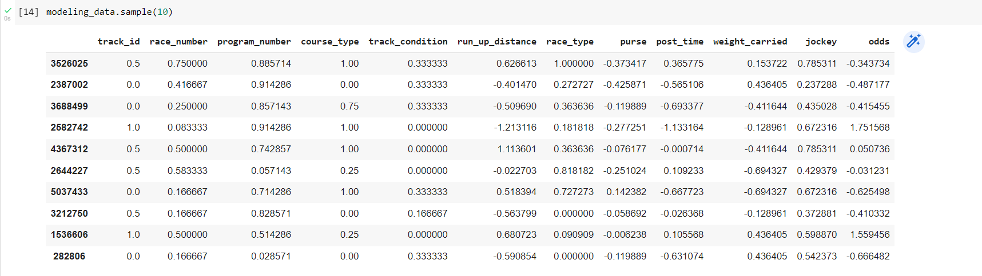
Preprocessing
After Preprocessing -
Removed unnecessary columns such as race_id, trackus_index, latitude, longitude, distance_id and duplicate rows. Performed data scaling and standardisation - MinMaxScaler for categorical data and StandardScaler for continuous data.

Slide 13
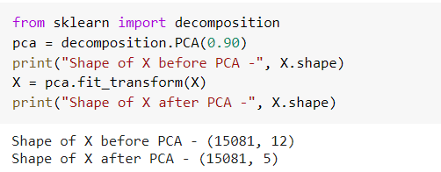
PCA
Performed PCA on the modeling_dataset -
Principal component analysis, is a dimensionality-reduction method. It transforms a large set of variables into a smaller one that still contains most of the information in the large set.
Easier, faster to explore and visualize (no extraneous variables to process)
Exactly 5 features explain 90% of the variance in the data.

Slide 14
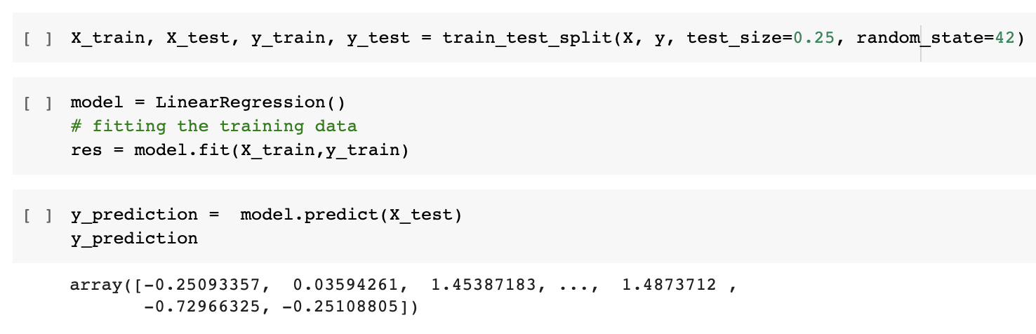
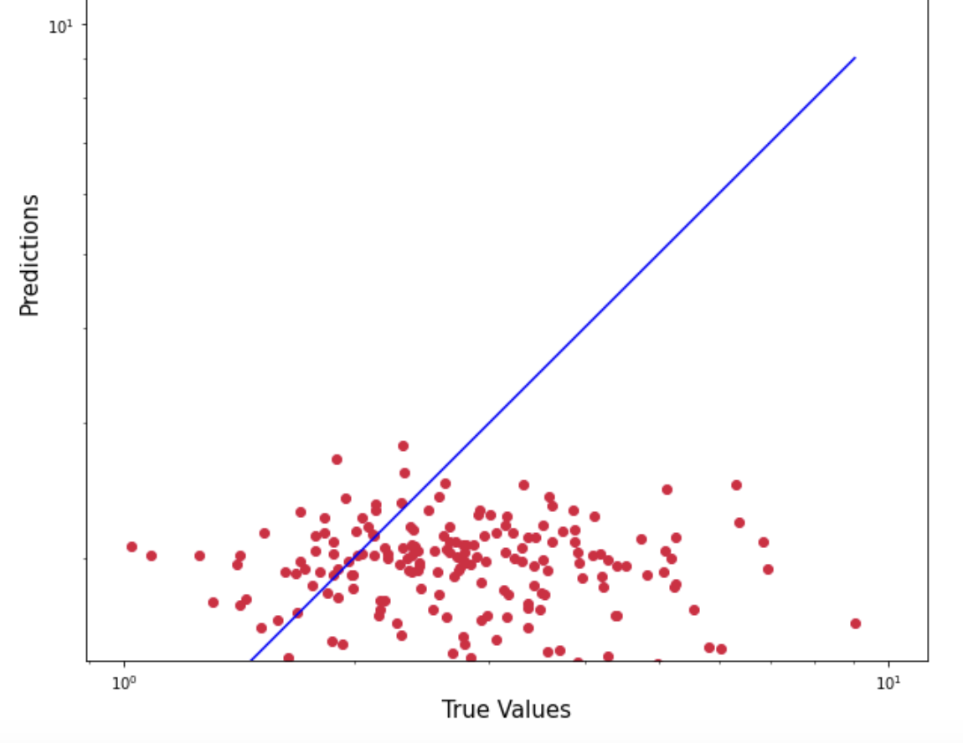
MLR
MLR - a linear relationship between numerous independent factors and a single dependent variable.
Scatterplot of log(Predicted values) vs log(True values)
Metric | Value
RMSE | 0.59646116
MAE | 0.55489073

Slide 15
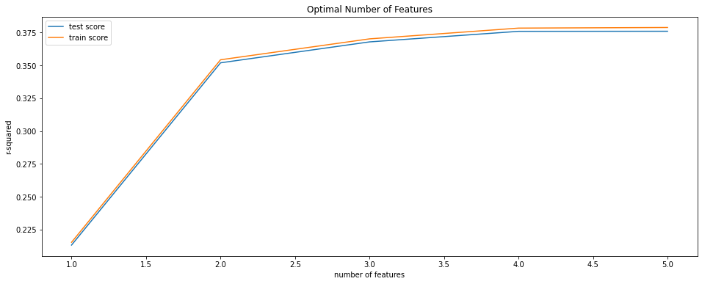
MLR - 5 fold cross validation
Validating PCA
Plot of R² vs number of features
R² stabilises after 5 features
Exactly what PCA returned!
Metric | Mean | Standard Deviation
R squared | 0.3685 | 0.0315
Negative MSE | -0.6303 | 0.053
Hardly any variation!
Confirms that the performance of the model is not fluctuating with varying test sets
Result isn’t very well
We explore and choose a neural network

Slide 16
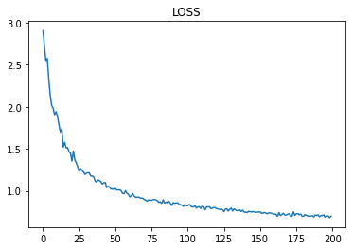
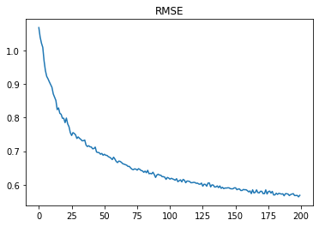
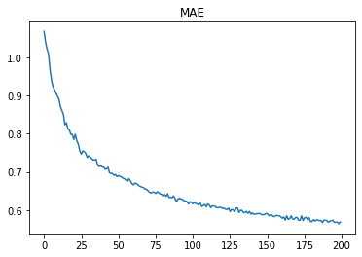
Neural Network
Epoch: 200
Batch Size: 200
Learning Rate: 0.0001
Optimizer: Adam Optimizer
Number of Layers
1 Input: 5 nodes
2 Dropout layers
1 Hidden: 15 nodes
1 Output: 1 node (for odds)
Activation functions: Linear and Relu
Mean Loss: 0.56776154
Mean RMSE: 0.52132695
Mean MAE: 0.52132695

Slide 17
Preprocessing (label encoding, scaling, feature selection,dimensionality reduction train-test split)
DL Neural Net
EDA
MLR
1
2
3
4
5
6
8
4
7
5
PCA (Reduced feature set from 12 to 5)
5-fold cross validation on MLR
Unsupervised Learning (k means & agglomerative clustering)
Inference

Slide 18

Thank You!

